Slide 1
Ruth Liberfarb, M.D., Ph.D.
Director, Stickler Syndrome Clinic
Mass. General Hospital for Children
16th American Stickler Syndrome Conference
Stickler Syndrome(s) Overview
Stickler Syndrome Clinic
July 14, 2012

Slide 2
STICKLER SYNDROME
Hereditary Progressive Arthroopthalmopathy
Stickler et al, 1965 & 1967
Inheritance: Autosomal Dominant (AD), Autosomal Recessive (AR)
Prevalence: 1 in 10,000
Penetrance: 100%
Variable expressivity-within a family and between families
Most common cause of hereditary retinal detachment (RD)
Most common cause of juvenile retinal detachment (RD)

Slide 3
Stickler Syndrome: Clinical Features
Ocular features: vitreoretinal degeneration, myopia, cataracts, retinal holes and detachments
Auditory features: high tone sensory neural hearing loss; hypermobile tympanic membrane
Craniofacial features: mid-facial hypoplasia, micrognathia, palate abnormalities (cleft palate, submucous cleft palate, bifid uvula, Pierre Robin anomalad)
Musculoskeletal abnormalities: mild spondyloepiphyseal dysplasia, loose joints, early onset degenerative arthritis
Cardiovascular abnormality: mitral valve prolapse

Slide 4
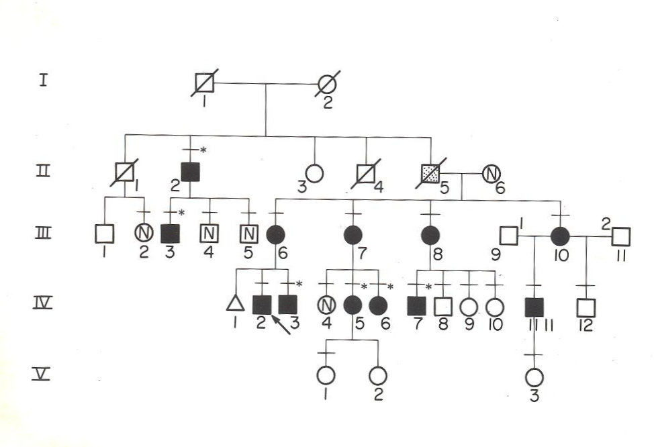
Pedigree of my first Stickler family
Liberfarb RM, Hirose T, and Holmes LB. The Wagner-Stickler syndrome –a genetic study. Birth Defects: Orig Artic Ser. 1979; 15 (5B): 145-154

Slide 5
Family Screening
Stickler Syndrome is one disorder where early diagnosis and treatment of eye problems can prevent blindness.

Slide 6
Type II Collagen Present in Cartilage and Vitreous
Structural gene for type II collagen: COL2A1
“Candidate gene “ hypothesis (Gusella et al., 1986) tests whether a mutation in a specific gene causes a particular hereditary disorder
Francomano CA, Liberfarb RM, Hirose T et al. The Stickler Syndrome: Evidence for Close Linkage to the Structural Gene for Type II Collagen. Genomics. 1987; 1: 293-296

Slide 7
Mutations identified as causing Stickler Syndrome phenotype
1990, 1991, premature stop codon (PTC) mutation in exon 40 of COL2A1 identified by Ahmad et al.
Subsequently, mutations - mostly premature stop codons, but also missense and splice site mutations- have been identified throughout the entire COL2A1 gene

Slide 8
Mutation identified in COL2A1 causing phenotype in original Stickler family
1996. A single base pair substitution in IVS17 such that the mutant allele utilized a cryptic splice site in exon 18, eliminating 16 bp at the start of exon 18. This frameshift results in a premature termination codon (Williams CJ et al. AM J Med Gen 1996; 63;461-467)

Slide 9
Mutation identified in COL2A1 causing phenotype in my first Stickler family
December, 2001 in NIH/NIA study: one nucleotide deletion in exon 49 of COL2A1 (c.36696delC) resulting in Stickler phenotype

Slide 10
STICKLER SYNDROME
GENETIC HETEROGENEITY
Gene Locus Year Inheritance
Membranous vitreous
  Type I (STL1) COL2A1 12q13 1990 AD
Beaded vitreous
  Type II (STL2) COL11A1 1p21 1996 AD
Nonocular
  Type III (STL3) COL11A2 6p21 1994 AD
Degenerated vitreous with
progressive liquefaction
  Type IV (STL4) COL9A1 6q13 2006 AR
  Type V (STL5) COL9A2 1p33-p32.2 2011 AR

Slide 11
Stickler Syndrome
Genetic Heterogeniety, cont’d.
Stickler Syndrome Type ? : (+) clinical diagnosis with location of mutation still unknown – no mutation found in COL2A1 or COL11A1-
ca. 30 % families in the NIH/NIA study

Slide 12
Mutations in COL2A1 and COL11A1
Richards et al. 2010. Human Genetics; 31: 1461-1471. Report on 75 mutations in COL2A1 and 14 mutations in COL11A1
Hoornaert et al. 2010. Mutations;18:872-881. Report on 77 different mutations in 100 individuals with COL2A1 mutations
NIH/NIA study : 47 mutations in COL2A1 and 5 mutations in COL11A1

Slide 13
NIH/NIA study
47 unrelated patients with mutations in COL2A1-majority have private ones –a few “hot spots”, for example:
3 families have a common mutation in arg 333 Ter, exon 23
2 families have same mutation IVS25 + 1G/2
2 families have same mutation arg732 Ter, exon 40
4 unrelated patients with mutations in COL11A1

Slide 14
Prevalence of clinical features based on 47 Stickler Syndrome Type I patients from 10 families with defined mutations in COL2A1 evaluated at NIH
Liberfarb et al., The Stickler syndrome: genotype/phenotype correlation in 10 families with Stickler syndrome resulting from seven mutations in the type II collagen gene locus COL2A1. Genet Med. 2003; 5:21-27

Slide 15
Clinical Features-Ocular
        Prevalence(%)
Vitreoretinal Degeneration 100
Myopia 100
Mild (< -5 diopters) 40
Moderate ( -5 –> -8 diopters) 16
High ( > -8 diopters) 32
Mixed or unspecified 12
Normal 0

Slide 16
Healthy compact vitreous
Type 1 Stickler syndrome
COL2A1 gene 12q13
Type 2 Stickler syndrome
COL11A1 gene 1p21

Slide 17
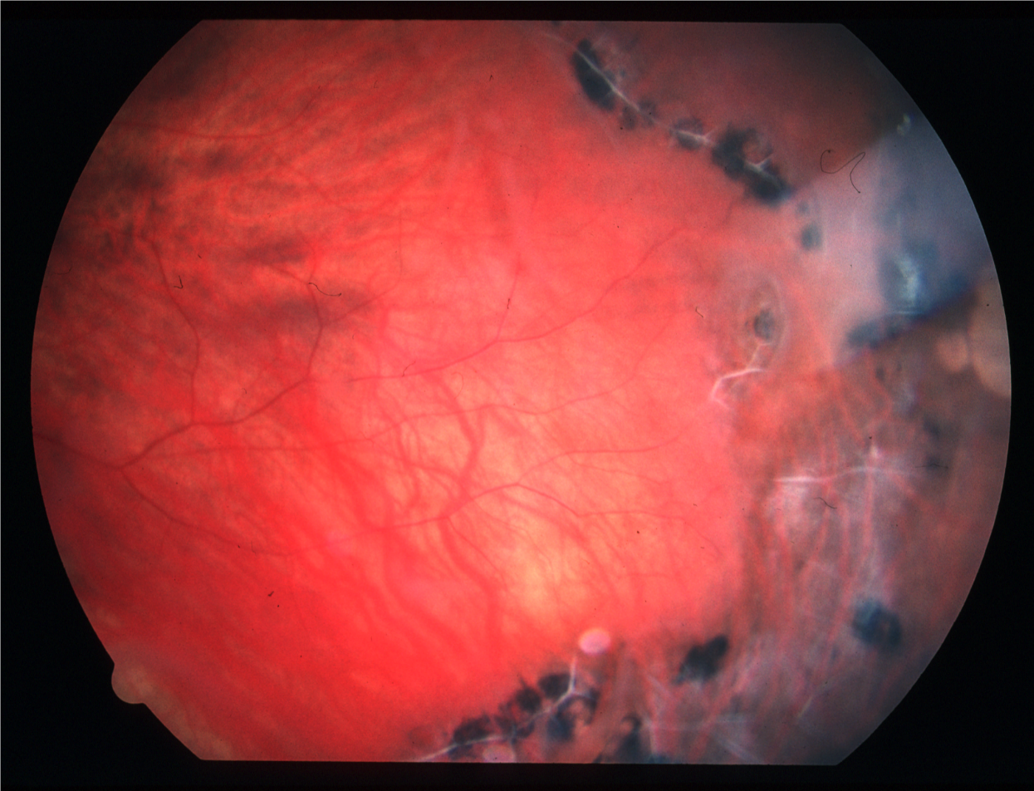

Slide 18
Clinical Features- Ocular
Prevalence(%)
Retinal Holes/Detachments 68
Cataracts 40
Glaucoma 8

Slide 21
Impression: High frequency
Sensorineural hearing loss (HFSNHL)
Audiogram from 17 y.o. patient with Stickler Syndrome type I

Slide 22
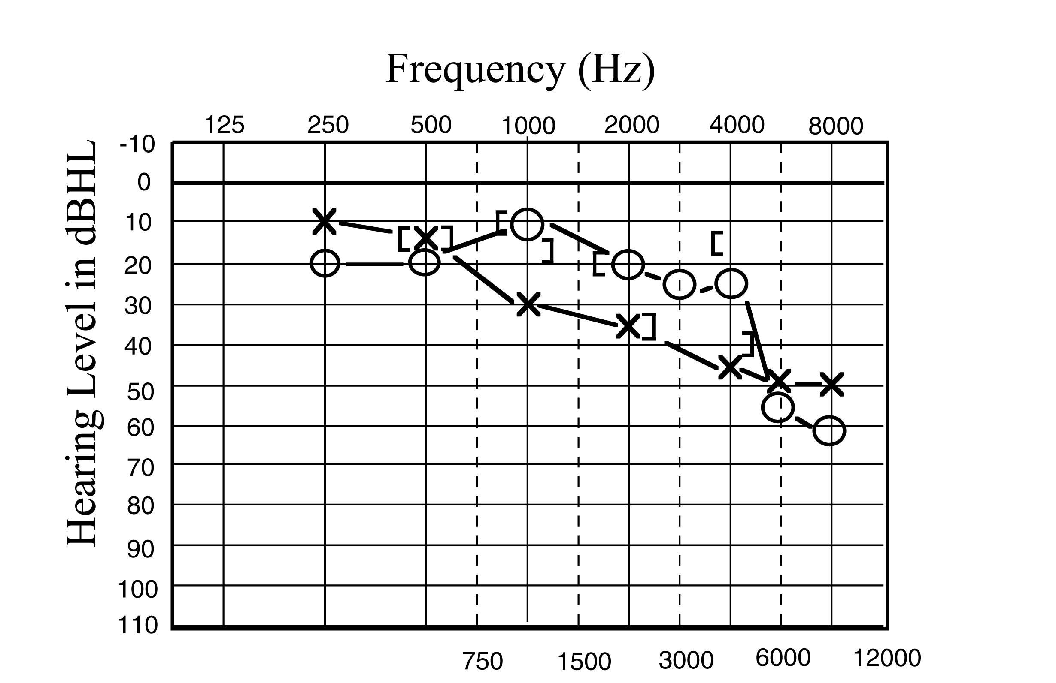

Slide 24
Clinical Features-Craniofacial
Prevalence (%)
Cleft palate 24
Bifid uvula and/or
Submucous cleft palate 32
  Robin sequence 8
  Midfacial hypoplasia 72
  Micrognathia 60

Slide 25
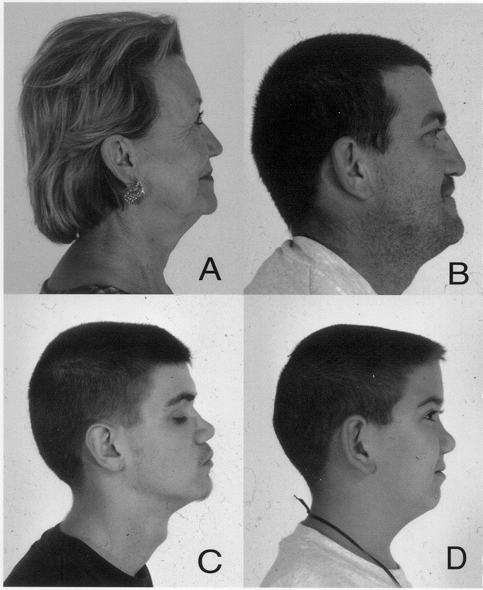

Slide 26
Clinical Features-Musculoskeletal and Cardiovascular
Prevalence (%)
Early onset degenerative 60
arthritis
Hyperextensible joints 52
Skeletal abnormalities 72
Mitral valve prolapse 4

Slide 28
Clinical Features - Skeletal
        Prevalence (%)
Pectus Carinatum 12
Pectus Excavatum 4
Endplate abnormalities 64
Scheurman-like Kyphosis 15
Schmorl’s nodes 8
Scoliosis 28
Platyspondyly 4
Spondylolisthesis 10
Legg- Calve-Perthes Disease 4
Slipped capitol femoral epiphyses 2
Hip Replacements 20
Knee Replacements 4

Slide 30
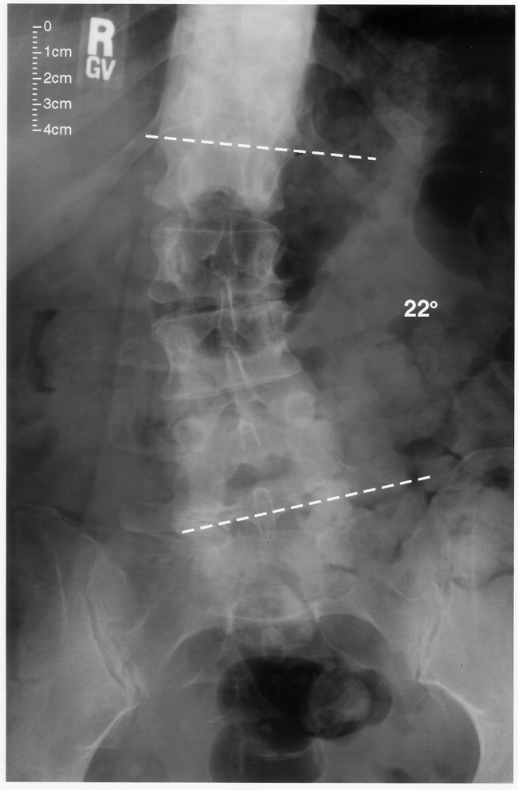

Slide 31
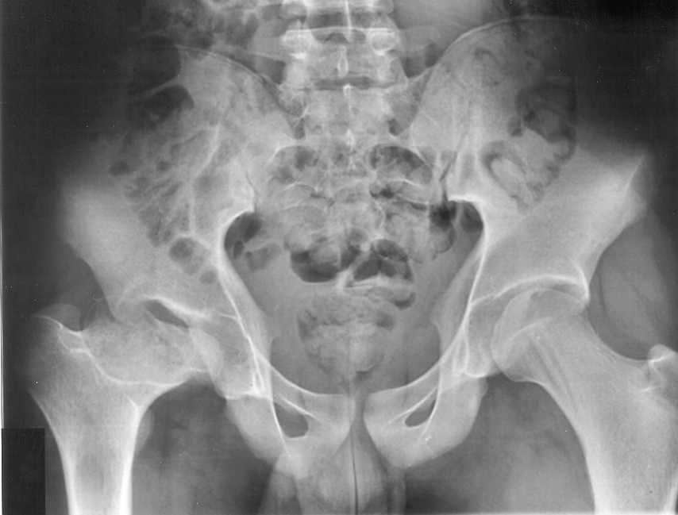
Notes:
Femoral head failure-both hips

Slide 32
Molecular Diagnoses of Stickler Syndrome in the NIH/ NIA Study
61 unrelated patients with clinical diagnosis of Stickler Syndrome
Mutations found for 47 (77%)
43 had mutations in COL2A1 (70%)
7 had mutations in COL11A1 (7%)
23 had no mutation found (23%)

Slide 33
Stickler Syndrome:
Differential Diagnosis
Wagner’s Disease
Marshall syndrome
Spondyloepiphseal dysplasia congenita
Spondyloepiphseal dysplasia tarda
Kniest syndrome
Weissenbocher-Zweymuller syndrome ? Stickler S. type III- mutation in COL11A2
Marfan syndrome

Slide 34
Wagner’s Disease
Bohringer et al., 1960; Ricci, 1960
Hirose et al., 1973: Retinal detachment commonly associated
Maumenee, 1979: Rare disease (one Swiss family) with ocular manifestations only
Mutation causing Wagner disease in the Swiss family mapped to chr 5q14.3 by Zechet al 1999

Slide 35
Marshall Syndrome
Marshall, D. Ectodermal dysplasia: report of a kindred with ocular abnormalities and hearing defect. Am. J. Ophthal. 45: 143-156,1958
Nasal defects and abnormal facies
Congenital and juvenile cataracts
Myopia and fluid vitreous
Sudden maturation and absorption of congenital cataracts
Luxation of cataracts
Congenital hearing loss
Ectodermal dysplasia
Ocular hypertelorism

Slide 36
Marfan Syndrome
First described in 1896 by A. Marfan, MD
Clinical features: marfanoid habitus, tall stature, loose joints, myopia,, vitreoretinal degeneration, retina detachment, dislocated lenses, aortic root dilatation, dural ectasia, early death
1990 genetic causation linked to mutation in gene for fibrillin on chr15q15-21.3

Slide 37
Diagnostic Criteria for Types I and II Stickler Syndrome, Rose et al., 2005
Diagnosis requires 5 or more points
At least one major manifestation
Absence of feature(s) suggestive of a more severe skeletal dysplasia (e.g. stature < 5th percentile); or other syndrome (e.g. dislocated lenses and aortic root dilatation)

Slide 39
Diagnostic criteria cont’d
Orofacial abnormalities (2 pts. max.)
2 pt. - major: palatal abnormalities
1 pt. - characteristic face (malar hypoplasia, flat or broad nasal bridge and micro/retrognathia)
Ocular abnormalities (2pts. max.)
2 pt. – major: characteristic vitreous changes and retinal
abnormalities
Auditory abnormalities (2 pts. max.)
2 pts. – major: High frequency sensorineural hearing loss
1 pt – hypermobile tympanic membrane

Slide 40
Stickler Syndrome Clinic
September, 2006 – June, 2012
Mission: evaluation and care of Stickler Syndrome patients
  104 patient visits
  49 Stickler S. type I patients - mutations in COL2A1
  7 Stickler S. type II patients - mutations in COL11A1
  9 Stickler S. type ? patients –(+) clinical diagnosis with no mutation found in either COL2A1 or COL11A1
  10 Stickler S. type unknown patients –(+) clinical diagnosis but patients did not have mutation analysis done
  1 Marshall Syndrome patient with mutation in exon 50 of COL11A1
  3 patients had diagnosis of Stickler S. ruled out- normal exam/ no mutation found
  - 15 Other

Slide 41
Stickler Syndrome Clinic
Why do patients make appointments?
1. Evaluation/ Diagnosis
2. Education, genetic counseling
3. Care of associated problems/ referral to specialists
4. Family screening
5. Reproductive options/ prenatal testing, preimplantation genetic diagnosis (PGD)

Slide 42
STICKLER SYNDROME CLINIC
EVALUATION
Comprehensive family and medical history
Physical examination
Identification of mutation by DNA analysis
Clinical tests: audiogram; echocardiogram; skeletal x-rays; DNA analysis
Referral to specialists

Slide 43
Identification of mutation by DNA analysis
Confirms clinical diagnosis
Allows for genotype/phenotype correlation
Facilitates expectant medical care such as prophylactic ocular management by laser treatment or cryotherapy which may prevent retinal detachment and blindness
Allows for prenatal testing or preimplantation genetic diagnosis (PGD)

Slide 44
Referrals to specialists
Ophthalmologist or retinal specialist-exam needed annually or more frequently if medically indicated
Audiologist-a hearing evaluation needed every 3-5 years
Orthodontist-for dental evaluation-? need for orthodonture
Rheumatologist or orthopedist-for musculoskeletal evaluation and treatment
Physiatrist-for pain management

Slide 45
Percutaneous Autologous Bone Marrow Transplantation to treat Avascular Necrosis of Bone (AVN)

Slide 46
Disorders caused by mutations in COL11A1
Stickler S. Type II
Marshall /Stickler S.
Marshall S.
Annunen et al., Am J Med Genet 65:974-983, 1999
Majava et al.,Am J Med Genet Part A 143A:258-264, 2007

Slide 47
Marshall Syndrome
Mutations in COL11A1
in exons 48-57,
“hot spot” in exon 50

Slide 48
Marshall/ Stickler Syndrome
Features of both Marshall and Stickler syndromes.Hard to distinguish between two.
Caused by a mutation in COL11A1- not in the “hot spot” for Marshall S.

Slide 49
Stickler Syndrome type ?
Clinical diagnosis of Stickler Syndrome –meet diagnostic criteria for Stickler type I or II
No mutation found in COL2A1 or COL11A1

Slide 50
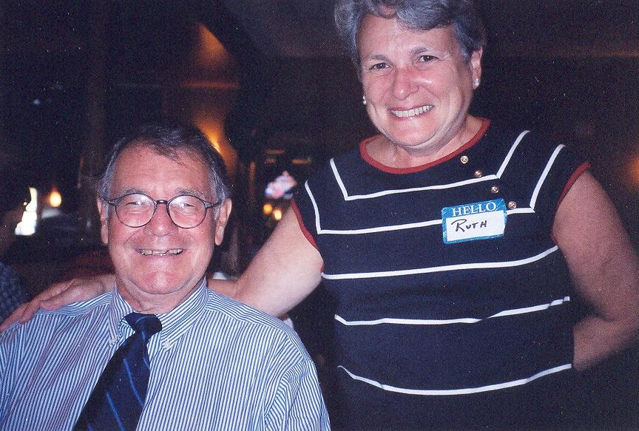

Slide 51
1925-Nov. 5, 2010
Gunnar B. Stickler, M.D.

Slide 52
FREEMAN, Dr. David L. Of Newton, MA, on July 8, 2012. Beloved husband of Dr. Amanda B. Freeman. Devoted father of Joshua, Daniel and his wife Natalie, and Aaron Freeman. Proud grandfather of Gil Parker and Delia Freeman. Loving brother of Joanne Grossman and her husband Marvin, and Judith Freedman and her husband Merton. David was very active at the Social Action Committee at Temple Israel. An accomplished pianist, he played for many charitable causes including nursing homes, Lahey Clinic, and Boston Piano Amateurs Association. He was a trusted and caring physician for many years. David and his beloved wife provided medical care to families needing assistance after natural disasters in Latin America. Services at Temple Shalom Newton MA, on Wednesday, July 11, 2012 at 12 Noon. Following interment, memorial observance will be at David and Amanda's residence until 7pm and will continue Thursday and Friday 4-7 pm. In lieu of flowers, donations in his memory may be made to Rabbi Carl and Barbara Friedman Scholarship Fund, Hebrew College, 160 Herrick Rd., Newton, MA 02459, or Temple Shalom, 175 Temple St., Newton, MA 02465. Brezniak-Rodman Chapel Brezniakrodman.com

