Slide 1
STICKLER SYNDROME
(Wagner-Stickler Syndrome)
Findings of the Retina
Tatsuo Hirose, MD
Clinical Professor in Ophthalmology,
Harvard Medical School
Boston
T. Hirose

Slide 2
HEREDITARY VITREORETINAL DEGENERATIONS
Heredity
Vitreous Degenerations Membranes
Retinal Degenerations Pigmentation
Impaired Retinal Functions Night Blindness
Retinal Detachment
T. Hirose

Slide 3
HEREDITARY VITREORETINAL DEGENERATIONS
Wagner’s vitreoretinal degeneration
Congenital retinoschisis
Vitreotapetoretinal degeneration
(Goldmann-Favre)
Familial exudative vitreoretinopathy
(Criswick & Schepens)
Snowflake degeneration
(Hirose, Lee, & Schepens)
T. Hirose

Slide 4
WAGNER’S HEREDITARY
VITREORETINAL DEGENERATION
Myopia
Cataract
Optically empty vitreous cavity,
avascular vitreous membrane
Retinal pigmentation, periphery,
along retinal vessels
Narrow sheathed retinal vessels
T. Hirose

Slide 5
WAGNER’S HEREDITARY
VITREORETINAL DEGENERATION
Retinal detachment
Choroidal atrophy
Subnomal b-wave of ERG
Concentric constriction of visual field
Cleft palate, Facial deformity
Autosomal dominant heredity
T. Hirose

Slide 6
Reprinted from the Archives of Ophthalmology
March 1973, Volume 89
Copyright 1973. American Medical Association
Clinical Sciences
Wagner’s Hereditary Vitreoretinal Degeneration and Retinal detachment
Tatsuo Hirose, MD: King Y. Lee, MD:
and Charles L. Schepens, MD.
T. Hirose

Slide 7
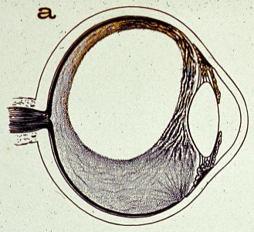
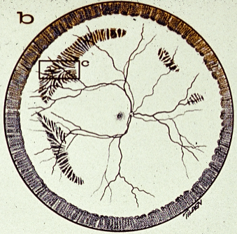
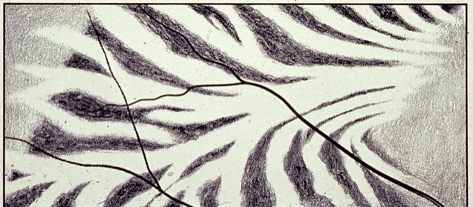
C
T. Hirose

Slide 8
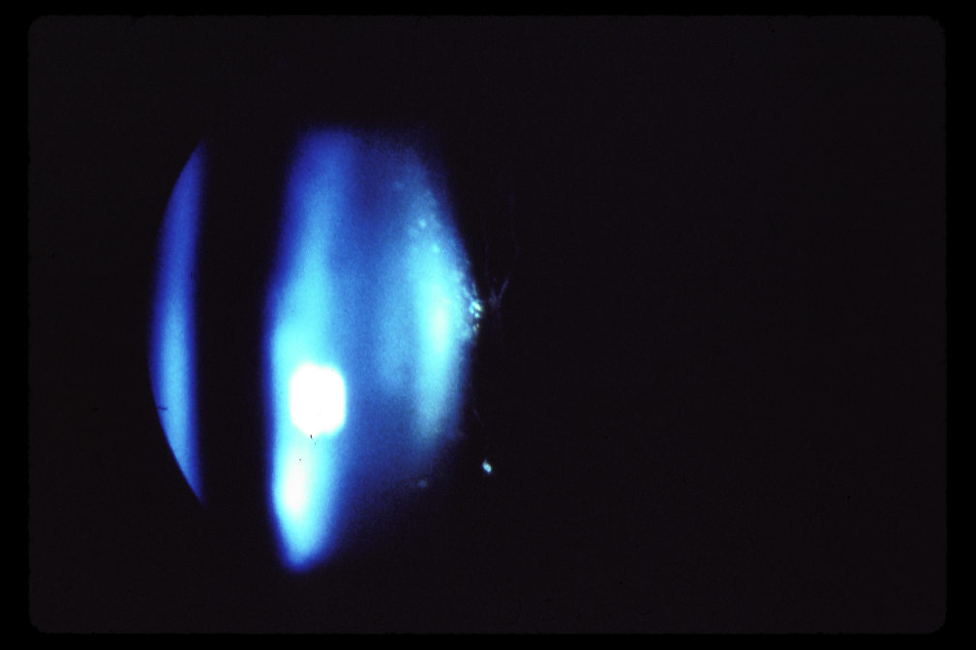
T. Hirose

Slide 9
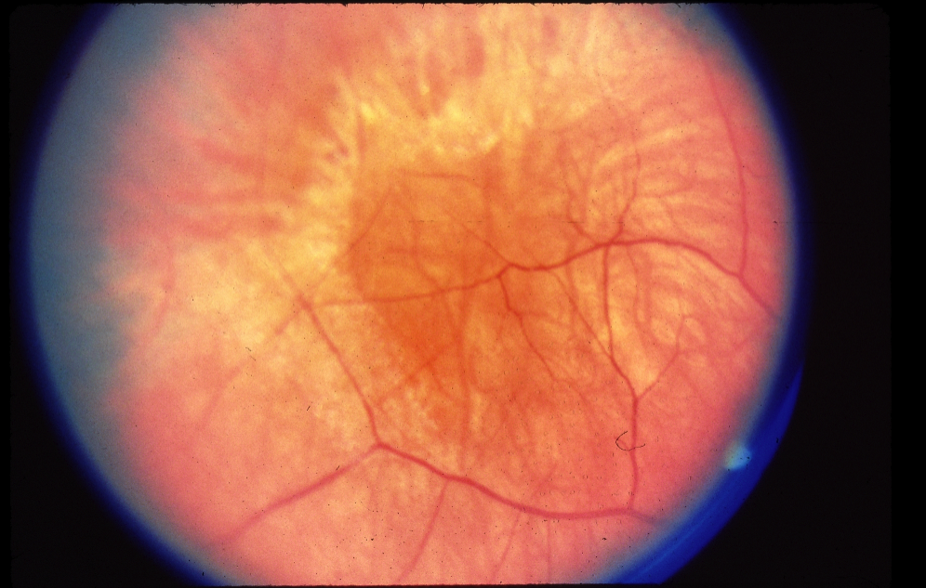
T. Hirose

Slide 10
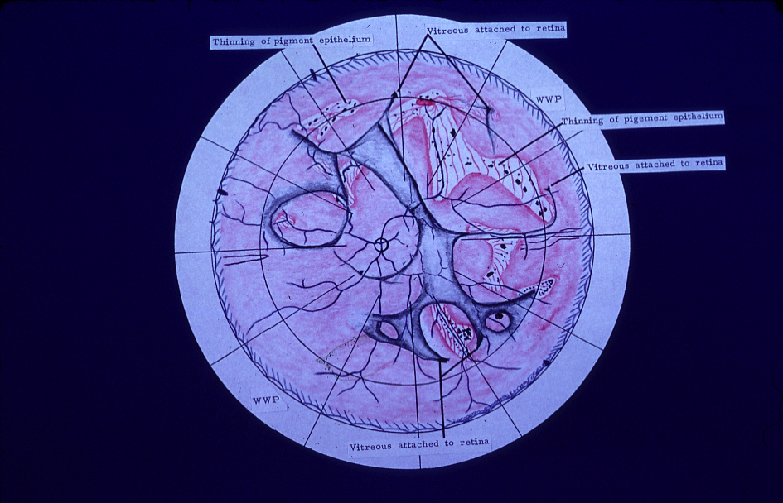
T. Hirose

Slide 11
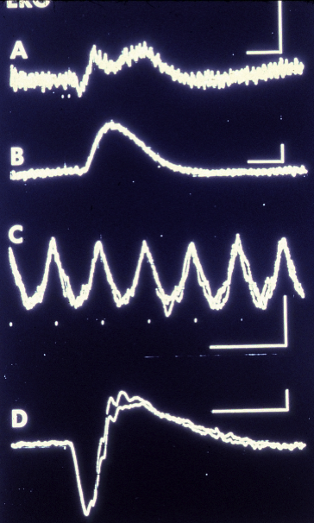
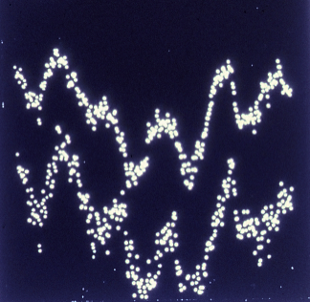
ERG
VER
T. Hirose

Slide 12

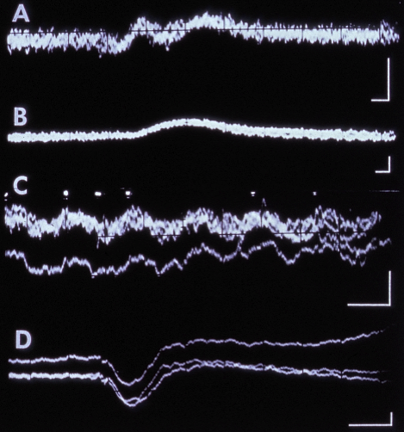
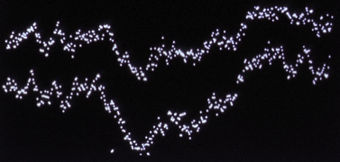
ERG OD
VER
T. Hirose

Slide 13
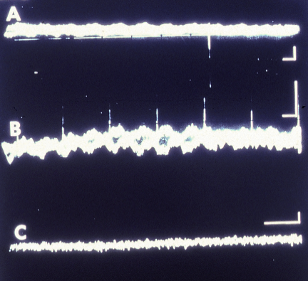
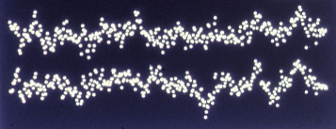
ERG OS
VER
T. Hirose

Slide 14
WAGNER’S DISEASE
Focal but extensive involvement of ?outer layer
Macular usually not involved
ERG relatively good although subnormal
EOG normal or abnormal
Dark adaptation may be impaired
T. Hirose

Slide 15
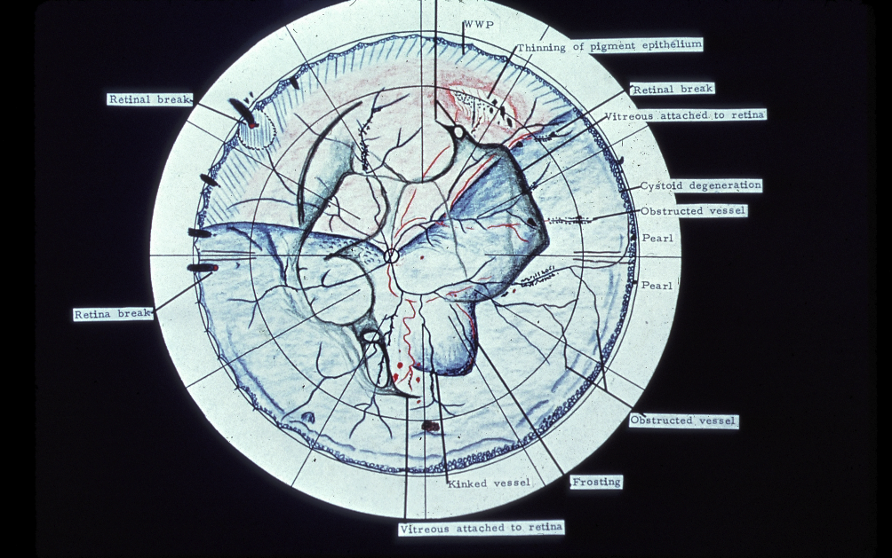
T. Hirose

Slide 16
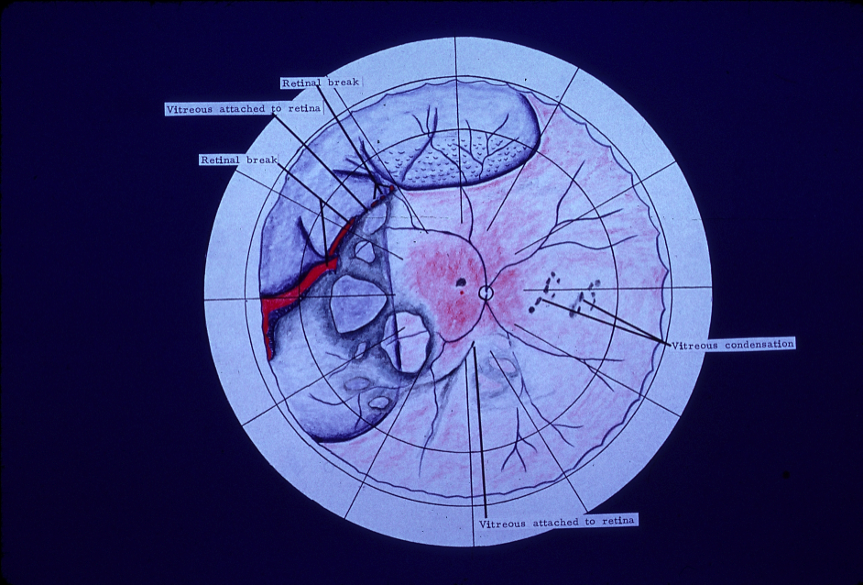
T. Hirose

Slide 17
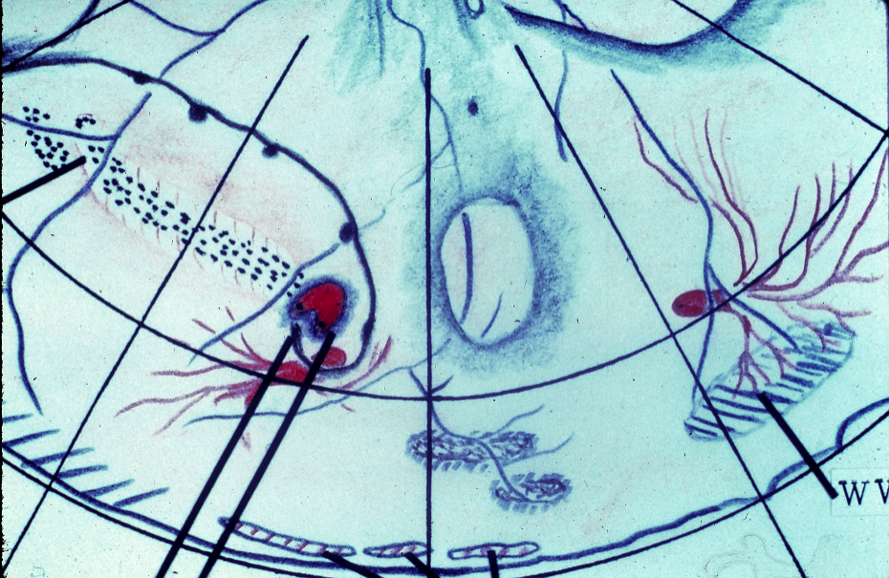
T. Hirose

Slide 18
Surgical results in
retinal detachment in
Wagner-Stickler Syndrome
84.2%
T. Hirose

Slide 19
RETINAL DETACHMENT IN
WAGNER’S DISEASE
Poor Prognosis
19 of 53 Patients Operated Upon
had Lost Fellow Eye
T. Hirose

Slide 20
RETINAL DETACHMENT IN WAGNER’S POOR
PROGNOSIS DUE TO:
Multiple Breaks
Often Large Breaks : Giant Tears
Prominent Vitreous Traction
Liquefied Vitreous Flowthrough
Sclerotic Vessels Bleeding
Cataracts
CRA with Poor Response to Rx
T. Hirose

Slide 21
Success in Prophylactic
Treatment in 39 Eyes
100%
T. Hirose

Slide 22
RETINAL DETACHMENT IN
WAGNER’S MANAGEMENT
Preoperative - Diagnosis
Vitreous and Retinal Exam
Surgery
Prevention of Complications
Recognition of Complications
Treatment of Complications
Postoperative
Close Follow-up
Fellow Eye
T. Hirose

Slide 23
WAGNER’S DISEASE - RECOMMENDATIONS
Examine Youngest Family Members
Follow Those with Findings
Educate Family
T. Hirose

Slide 24
WAGNER’S ORIGINAL DESCRIPTION 1938
Hereditary Hyloideoretinal Degeneration
Optically empty vitreous with mobile “threads”
and membranes
Retinal venous constriction
Occasional disc pallor
Foci of choroidal atrophy and retinal pigmentation
Early onset cataracts
Myopia of varying degrees
Constricted visual fields
Not retinal detachment
T. Hirose

Slide 25
STICKLER SYNDROME (1965)
HEREDITARY PROGRESSIVE ARTHO-OPHTHALMOLOGY
Ocular signs
Myopia
Presenile Cataract
Vitreous Degeneration
Retinal Pigmentation
Retinal Break and Detachment
T. Hirose

Slide 26
STICKLER SYNDROME
Orofacial Sign
Midfacial Hypoplasia
Small Chin
Cleft Palate
Abnormal Teeth
T. Hirose

Slide 27
STICKLER SYNDROME
Musculocutaneous Signs
Joint Hyperextendability
Enlarged Joint
Early Degenerative Arthritis
Hypotenia and Muscle Hypoplasia
Spondyloepiphyseal Dysplasia
Hearing Loss
T. Hirose

Slide 28
WAGNER’S DISEASE = STICKLER SYNDROME
HALL 1974
HERMANN 1975
KNOBLOCH 1975
LIBERFARB 1979
T. Hirose

