Slide 1
Coordination of Rare Diseases at Sanford (CoRDS): an international patient registry at Sanford Research
Liz Wheeler
SIP Annual Meeting
July 11, 2014

Slide 2
Thank you for having me! It is great to be here at the 18th Annual SIP Conference!

Slide 3
Overview of Presentation
Introduction
Mission & Goals
Partnership with SIP to a create disease-specific registry
Enrollment (Very Brief!)
Data Collection, Management, Dissemination
Future Steps

Slide 4
About Sanford Health
Notes:
One of the top 50 largest non-for-profit healthcare organization (revenue)
Largest rural health care system in the US
Service area equates the first largest state in the US

Slide 6
About CoRDS & Sanford Research
Sanford Research in Sioux Falls, SD
Established at the Children’s Health Research Center by Dr. David Pearce
Central International Patient registry for all rare diseases and all ages
Those who speak & understand English may enroll
Notes:
3.2 billion operating budget
Largest rural healthcare 501©3 non-profit organization in the US
2007 Mr. Sanford donated 400 million dollars to Sanford Health

Slide 7
Why CoRDS??

Slide 8
Our Mission
Mission: To accelerate research into rare diseases
Goal: To establish an international rare disease patient registry for all rare diseases
Create resource of contact and clinical data on individuals diagnosed with any rare disease to do a comparative analysis across disease
Provide a mechanism by which researchers can identify and contact patients interested in participating in research
Notes:
CoRDS is a research study with human subjects oversight from Sanford Health IRB
Talk about Unmet Need
Mission
Goals
Very low number of patient advocacy groups that have a rare disease registry

Slide 9
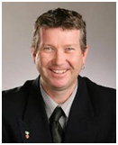
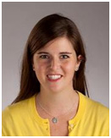
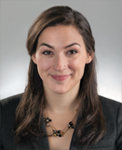
CoRDS Team
David Pearce, PhD
Principal Investigator
Liz Donohue Director
Raeann Bourscheid
Clinical Research Associate
CoRDS Scientific Advisory Board
Sanford Research Institutional Review Board (IRB)
Sanford Health Research Information Technologies (RIT)
Sanford Health Information Technologies (IT)
Sanford Health Marketing & Digital Strategies
Sanford Health Foundation
Notes:
3 FTES
Other Supports built in through health system

Slide 10
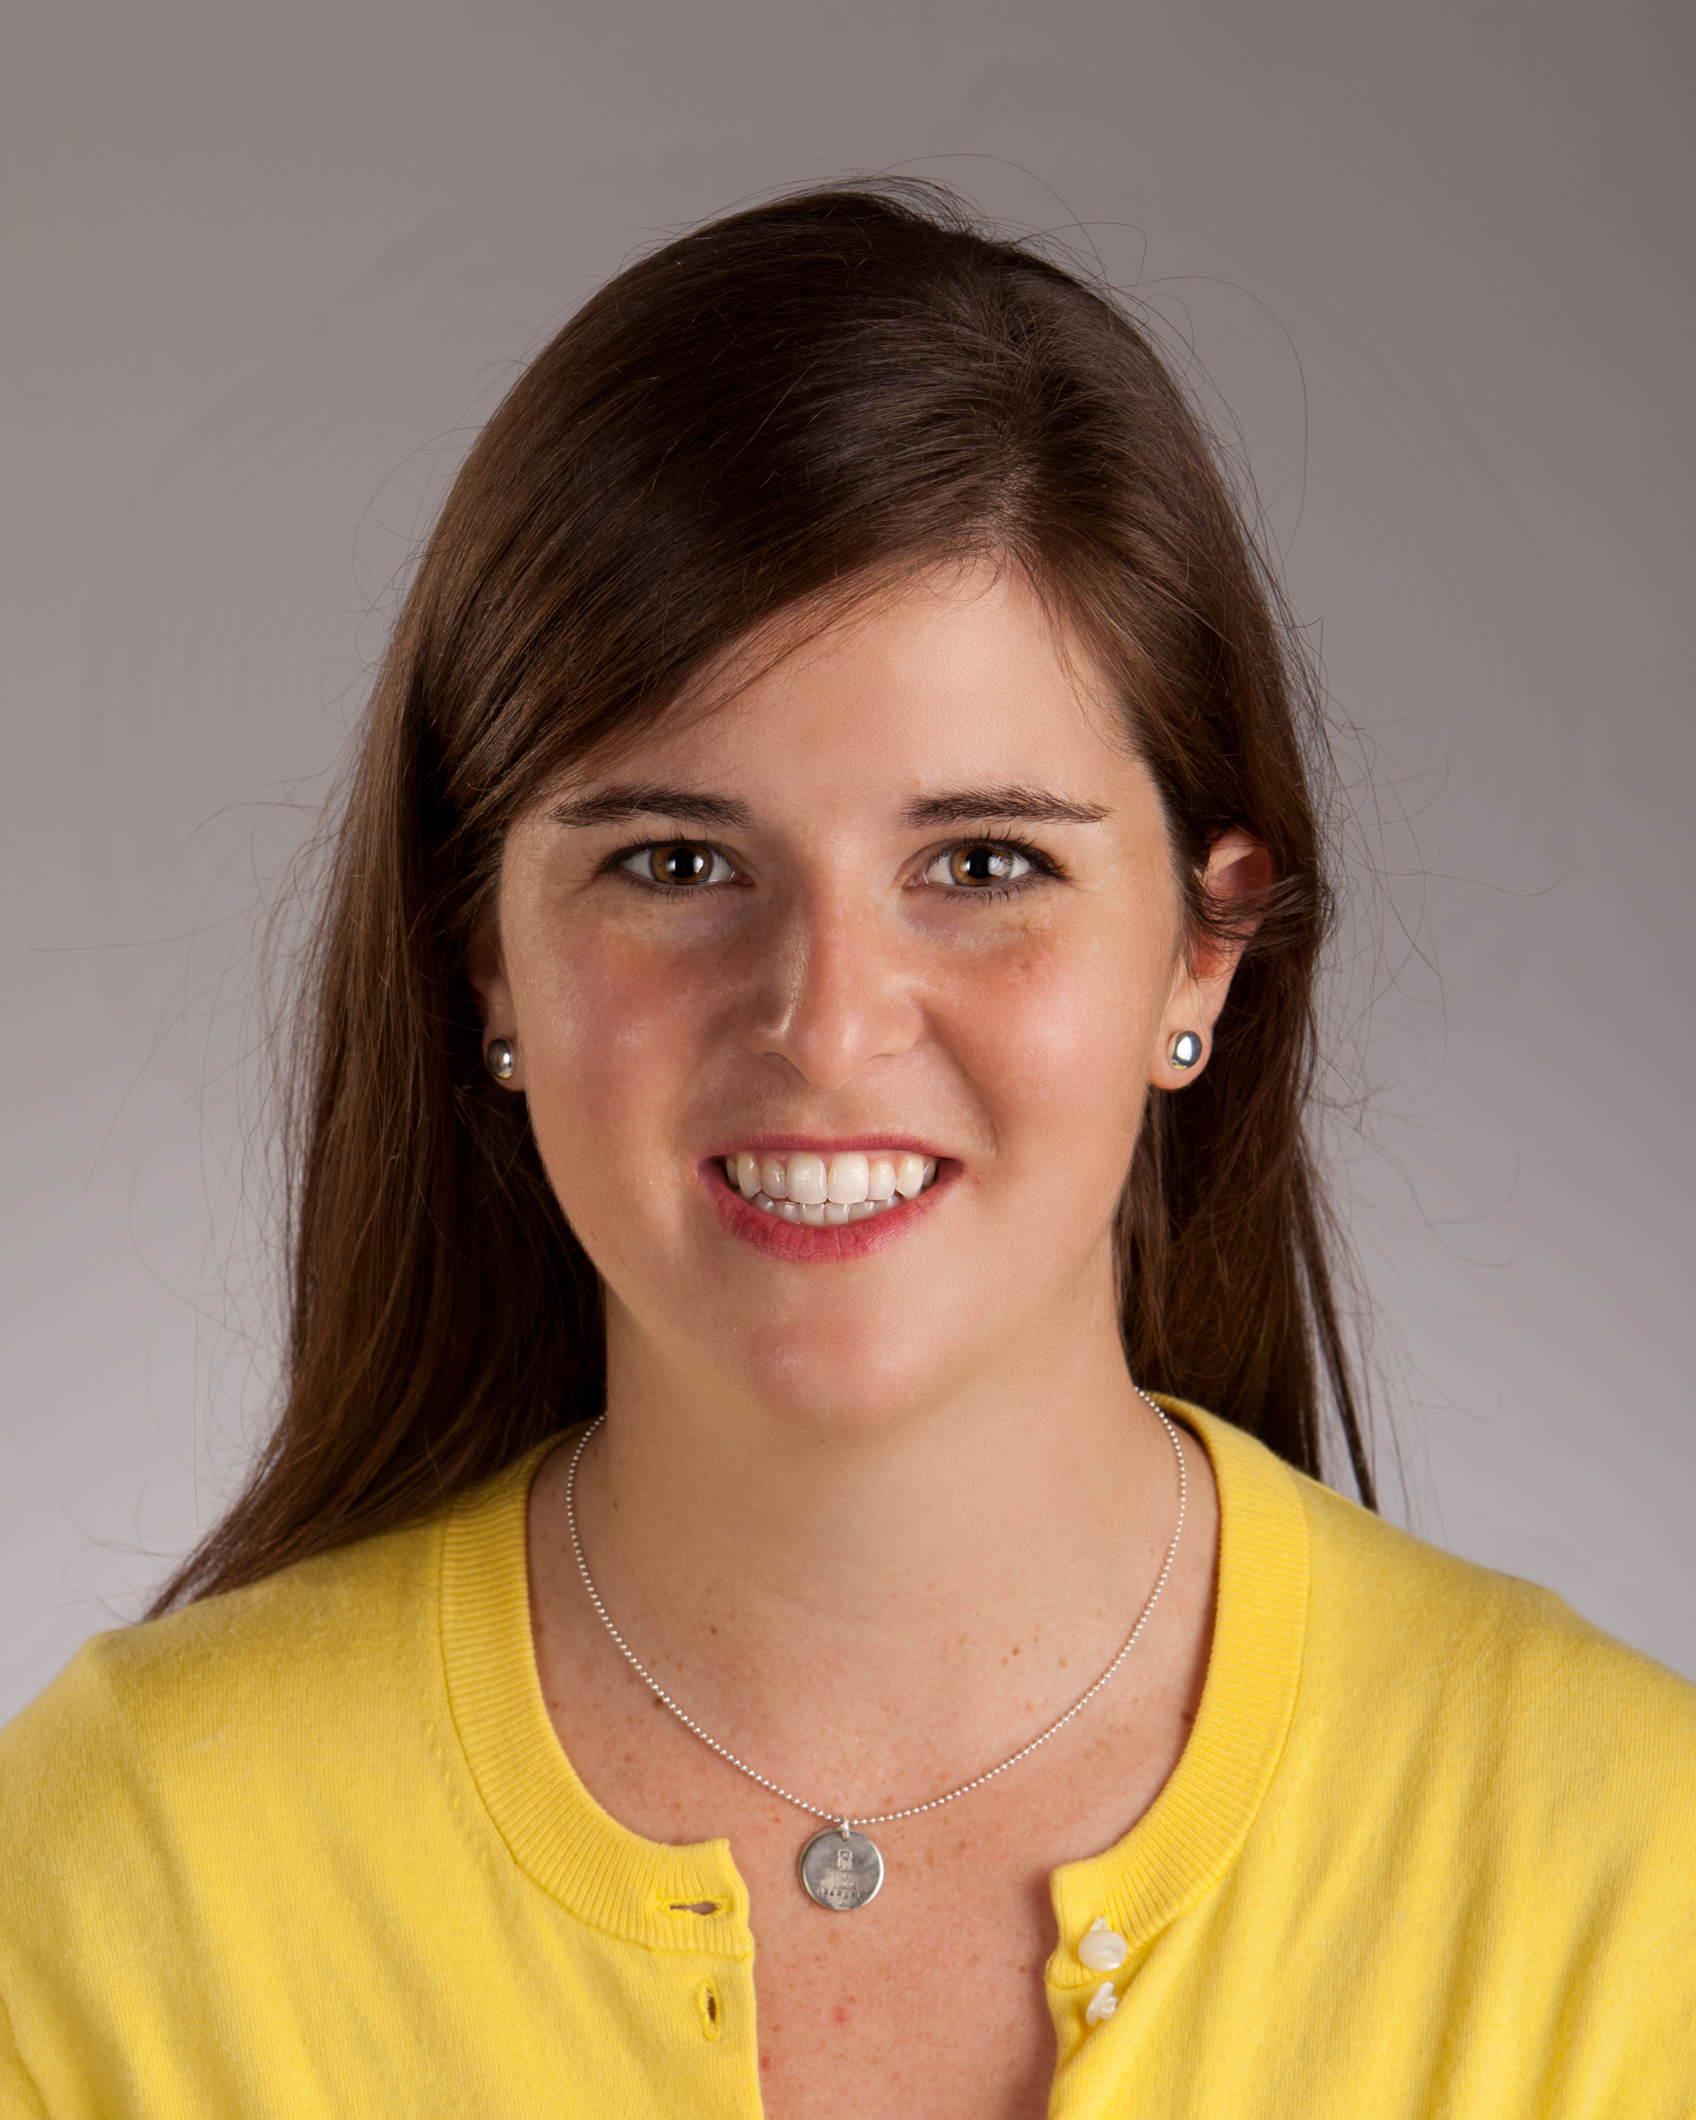
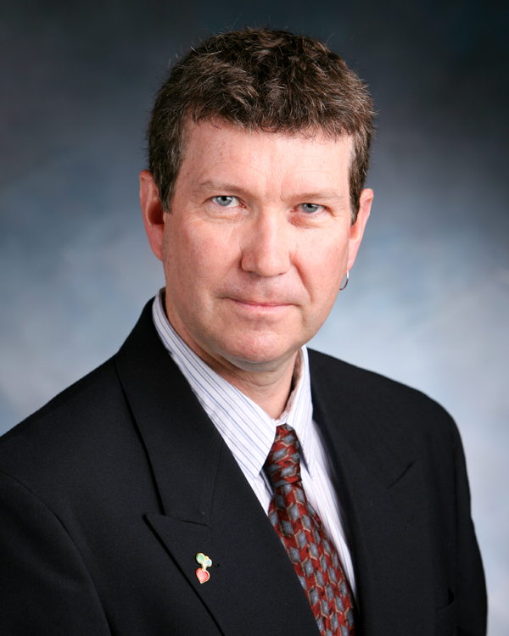
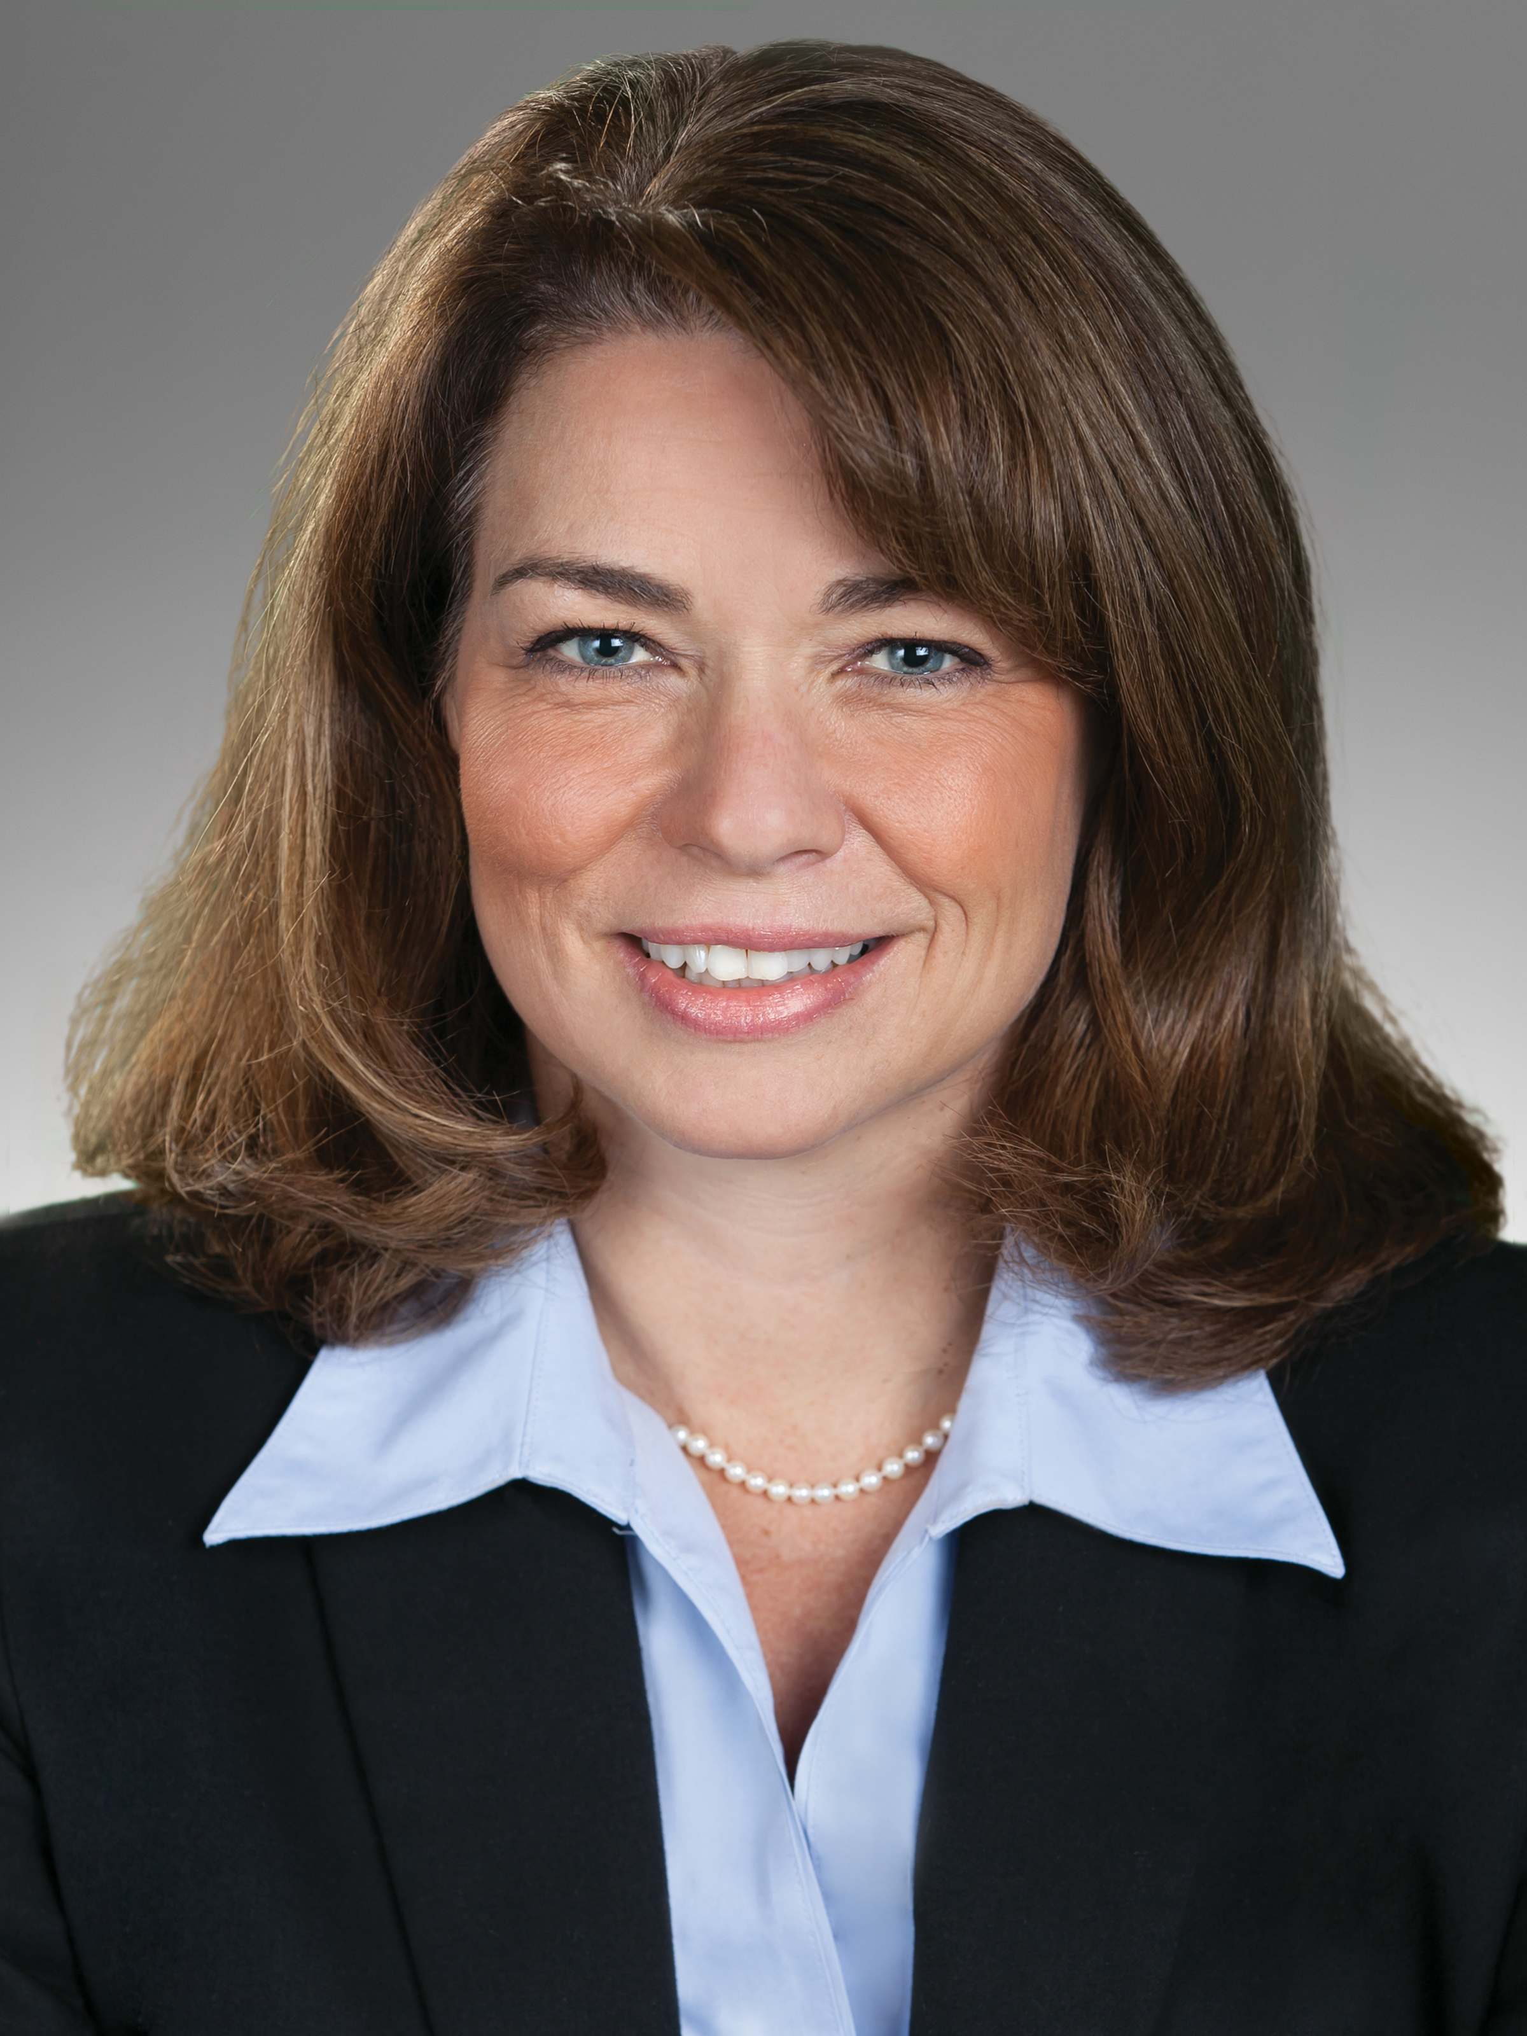
CoRDS Scientific Advisory Board (SAB)
Michelle Baack, MD, Neonatologist, Sanford Health; Associate Scientist, SCHRC
Angela Myers, MD,
Pediatric Geneticist,
Sanford Health
David Pearce, PhD,
Sr Scientist & Director SCHRC
VP, Sanford Research
COO of Research, Sanford Health
Liz Wheeler, Director, CoRDS, Sanford Research
Kyle Roux, PhD,
Scientist, SCHRC, Sanford Research
Sarah Jones, MD
Pediatric Surgeon, Sanford Health
Michael Kruer, MD,
Pediatric Neurologist, Sanford Health; Associate Scientist, SCHRC
Verle Valentine, MD
Orthopedic & Sports Medicine, Sanford Health

Slide 11
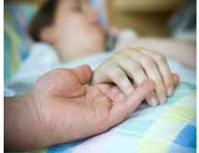
CoRDS is a patient registry established to help stakeholders in the rare disease community
Researchers
may access important data and have a way to notify individuals about research studies
Patients and Families
learn of research studies & clinical trials for which they are eligible
Patient Advocacy Groups
partner with CoRDS to establish a patient registry

Slide 12
What is a Rare Disease??
According to the Rare Disease Act of 2002, a rare disease is a “disease affecting less than 200,000 people in the United States”

Slide 13
Global Genes | RARE Facts
Approximately 7000 known rare diseases
~30 million in the United States, 350 million people worldwide
~80% Genetic Origin
~50 % Affect Children
Approximately 50% of rare diseases do not have a specific foundation supporting or researching their disease
Source: https://globalgenes.org/rarefacts/
Notes:
Over 7,000 types of Rare Diseases
Affect 30 million Americans, ~1 in 10
80% of rare diseases are genetic in origin
75% of rare diseases affect children
30% of children with rare diseases will not live to see their 5th birthday

Slide 14
Value of Studying
Rare Diseases
“Paradox of Rarity”: Diseases may be rare, but there are many rare diseases
Rare and Common diseases have similar symptoms. By studying rare diseases, we may learn about common diseases.
Source: “Paradox of Rarity” Rare Diseases: understanding this Public Health Priority” European Organization for Rare Diseases (EURODIS) November 2005. Accessed November 2, 2010 at http://www.eurordis.org/IMG/pdf/princeps_document-EN.pdf

Slide 15
What is a Patient Registry?
Organized program for
collection, storage, retrieval
and dissemination of a
clearly defined set of data
collected on identifiable individuals for a specific and specified purpose
Source
Richesson, R Rare Diseases Epidemiology Advances in Experimental Medicine and Biology, 2010, Volume 686, Part 2, 87-104.

Slide 16
Why do we need patient registries?
Patient Registries serve all those who are stakeholders in the development of effective therapies for rare diseases
Patients and families and their advocacy groups who are seeking information
Researchers who are studying rare disease
Epidemiologists who analyze information on rare disease
Drug companies looking to develop treatments
Rubinstein, Yaffa et al. Creating a global rare disease patient registry linked to a rare diseases biorepository database: Rare Disease-HUB (RD-HUB) Contemporary Clinical Trials. 2010 Sep;31(5):394-404. Epub 2010 Jul 8

Slide 17
Value of Rare Disease Registries
"Creating a registry of patients is the single most valuable action a rare disease community can take. The registry provides critical disease knowledge which makes that disease easier to study, increasing the probability a treatment can be developed.”
-David Meeker, president and CEO of Genzyme
Source
http://www.raps.org/focus-online/news/news-article-view/article/2646/2012-the-year-of-the-patient-registry.aspx

Slide 18
What makes CoRDS unique?
First of it’s kind; Central resource for all rare diseases; allows for comparative analysis across diseases
Unique collaboration with Patient Groups to establish a registry and customize a questionnaire
Any researcher with IRB approval would have access to the information following review from advisory panel
Enrollment option for individuals who are not represented by a rare disease organization & those who are undiagnosed
No cost for patients and families to enroll, no cost for researchers to access, no cost for patient groups to start a registry

Slide 19
How Does CoRDS work?

Slide 20
How Are Patients & Families involved?
Participants that enroll will complete can contribute information to the CoRDS database by filling out a brief questionnaire
Participants may learn about research opportunities for which they are eligible
When notified about research opportunities, they have the ability to decide whether or not they would like to participate

Slide 21
How do Researchers Access CoRDS?
Submit Brief Application to CoRDS with IRB approval
Log-in and Access de-identified information
Conduct a comparative analysis across many if not all rare diseases
Identify participants individuals interested in participating in research
CoRDS Personnel contact participants on behalf of the researcher

Slide 22
How is SIP Involved?
Organizations without a registry can partner to establish a registry
Services offered:
General or Customized questionnaires available
IRB (Institutional Review Board) approved
Software infrastructure in place for secure data collection & management
Sanford IT personnel in house located on site

Slide 23
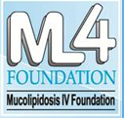
Over 40 CoRDS Partners

Slide 24
Enrollment Options
1.Online Enrollment
Web-based enrollment platform (April 2012)
2. Mail-Based Enrollment
3. In-person Enrollment
Patient Advocacy Group annual meetings
Sanford Health clinics

Slide 25
Online Enrollment
Step 1:
Participant completes CoRDS Registry Screening Form on CoRDS website sanfordresearch.org/cords
Participant receives unique username & password via email or receives the forms by mail.

Slide 26
Online Enrollment
Step 2:
Participant Logs-in with Username & Password Completes Informed Consent & Questionnaire
*CoRDS Contacts Participants Annually to update their information. Participant’s may log-in anytime to update their information

Slide 27
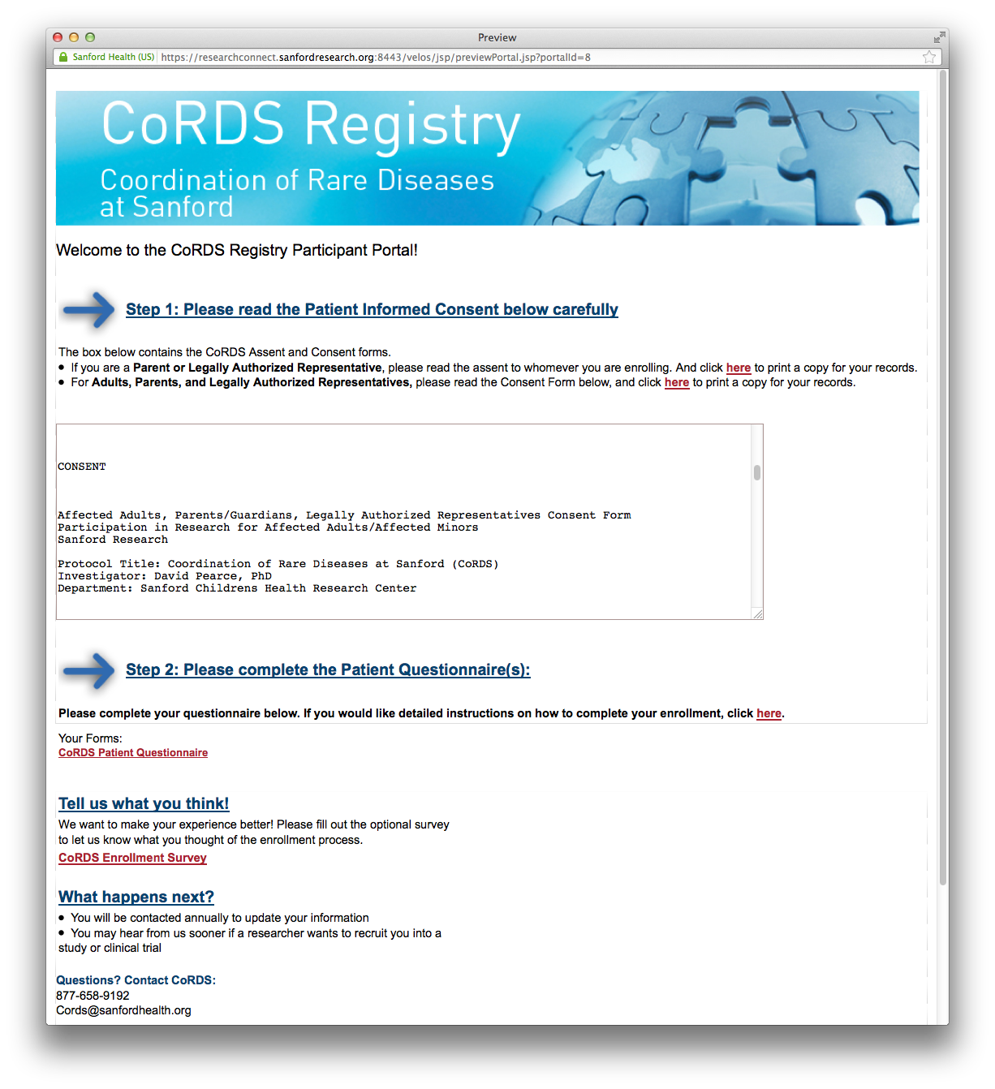
Informed Consent & Questionnaire

Slide 28
CoRDS Questionnaire
Includes the Common Data Elements (CDES)* recommended by the Office of Rare Disease Research
Contact information
Contact, Communication & Data-Sharing Preferences
Socio-demographic information
Family History
Symptoms & Diagnosis
Functional Disability Rating Scale
Clinical Research Participation

Slide 29
Enrolling at SIP Annual Conference!
Informed Consent Form and CoRDS Questionnaire available for pick-up
Read the Informed Consent & Complete the Questionnaire and return to me
The questionnaire is brief and takes about 10 minutes to complete.
I am here to answer any questions you have!

Slide 30
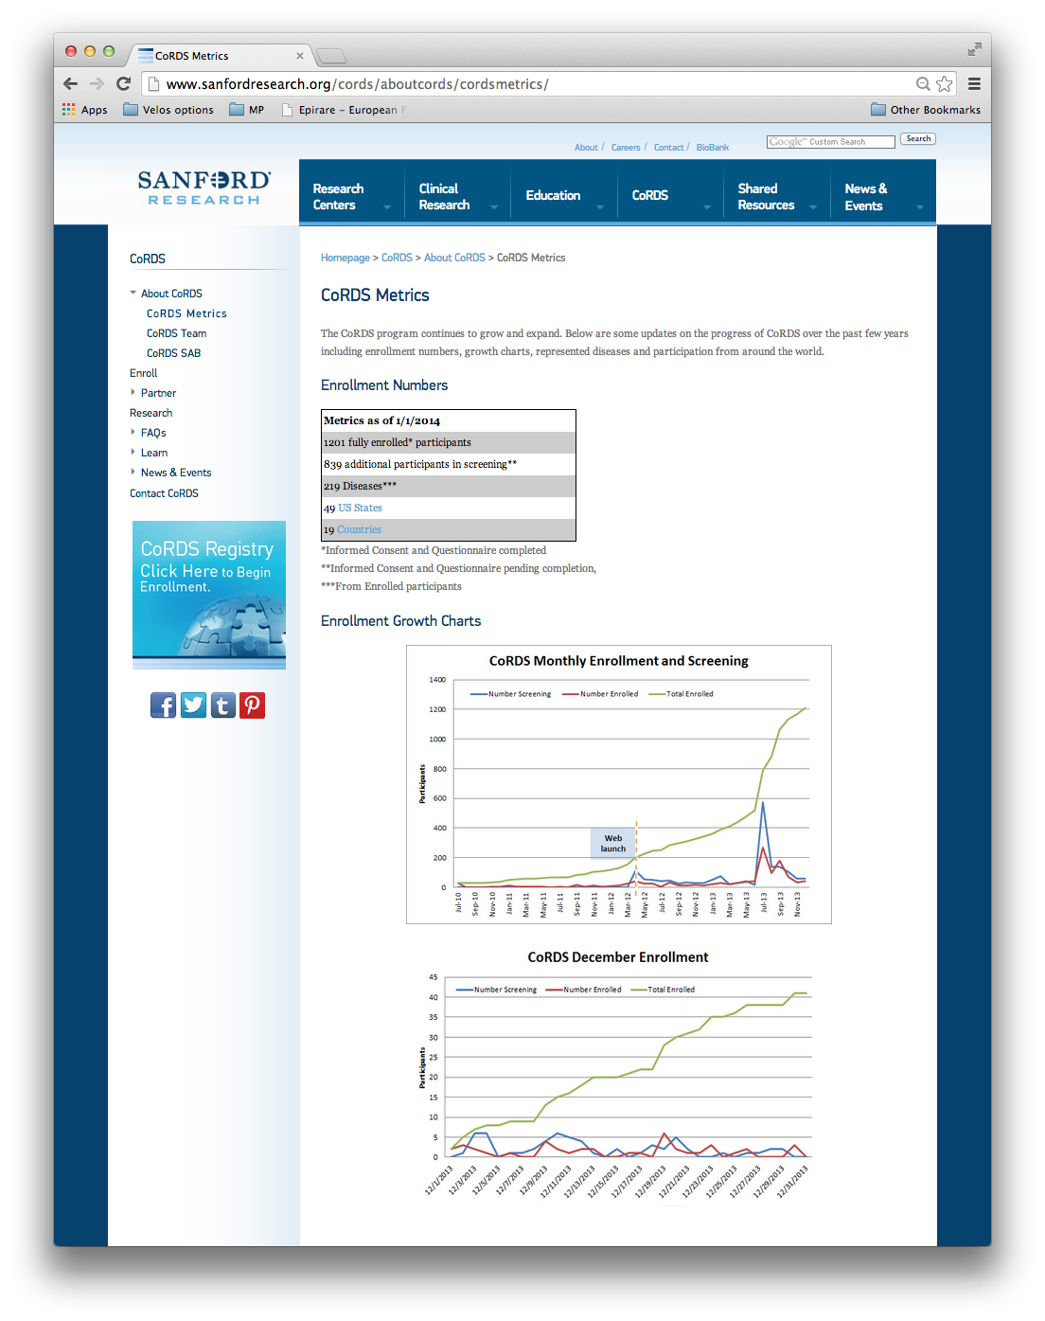
As of July 10, 2014 Enrolled Participants*:1539 Unique Rare Diseases: 271 Participants from: 50 US States 21 Countries More Metrics & a list of Diseases Represented in CoRDS on our website
CoRDS Metrics

Slide 31
CoRDS Registry 2010-2014

Slide 32
CoRDS Registry Software
Velos E-Research Software
Centralized, relational database of rare disease data
CFR 21, part 11 compliance, with 2-level authentication for data entry and modification
A granular security mechanism that allows user security to be restricted by user role or individual user, by organization, and by study or registry
Provides a mechanism to securely collect, modify, display, & report data
Secure patient portal allows for online enrollment

Slide 33
Coming Soon!
New and Improved Registry Software will make it easier for participants to enroll in one simple step and will provide an improved user interface!
If you want to update information online in the future, please indicate on your questionnaire, and CoRDS will send you instructions username and password to login.

Slide 34
Other Projects, Collaborations & Events

Slide 35
CoRDS Biobank
Approved February 2014
Repository of samples from patients diagnosed with rare diseases
Collect samples and make available to researchers studying rare diseases
House samples for repositories that do not have location or space at no cost
Samples collected include blood and saliva samples

Slide 36
International Rare Disease Research Consortium (IRDiRC)
Coordinates international collaborative efforts of leaders industry & research dedicated to rare disease
2 main objectives by the year 2020:
deliver 200 new therapies for rare diseases
diagnostic tools for most rare diseases
David Pearce, PhD nominated to Executive Committee (February 2012)
Liz Donohue Patient Registry Working Group (February 2013)

Slide 37
Annual Sanford Rare Disease Symposium
Held on the last Friday in February in honor of Global Rare Disease Day
Purpose: to raise awareness of rare disease research and advocacy efforts among healthcare providers and the rare disease community
Education credits: CMES/CEUs
Videoconferencing available
Exhibit Booths and Networking opportunities for Patient Advocacy Groups
Save the Date: 5th Annual Sanford Rare Disease Symposium, February 27, 2015

Slide 38
Questions?
Liz Wheeler
Director, CoRDS
605.312.6413
Liz.Wheeler@sanfordhealth.org
www.sanfordresearch.org/cords

